Slide 1

Cloud Storage Giants: A Comparative Overview
Explore Google Cloud Storage, AWS, and Azure: the titans of cloud storage. Understand their significance in modern distributed systems. Learn about scalability, reliability, and accessibility. This presentation covers features, use cases, differences, and real-world applications.

Slide 2
Key Features: Google Cloud Storage (GCS)
Object Storage
Storage Classes
Integration
Store unstructured data. Enjoy global accessibility.
Optimize costs based on access frequency. Options include Standard, Nearline, Coldline, and Archive.
GCS has seamless integration with other Google Cloud services like BigQuery and Dataflow.
Archive storage for infrequently accessed data like backups reduces costs by up to 80% compared to Standard.

Slide 3
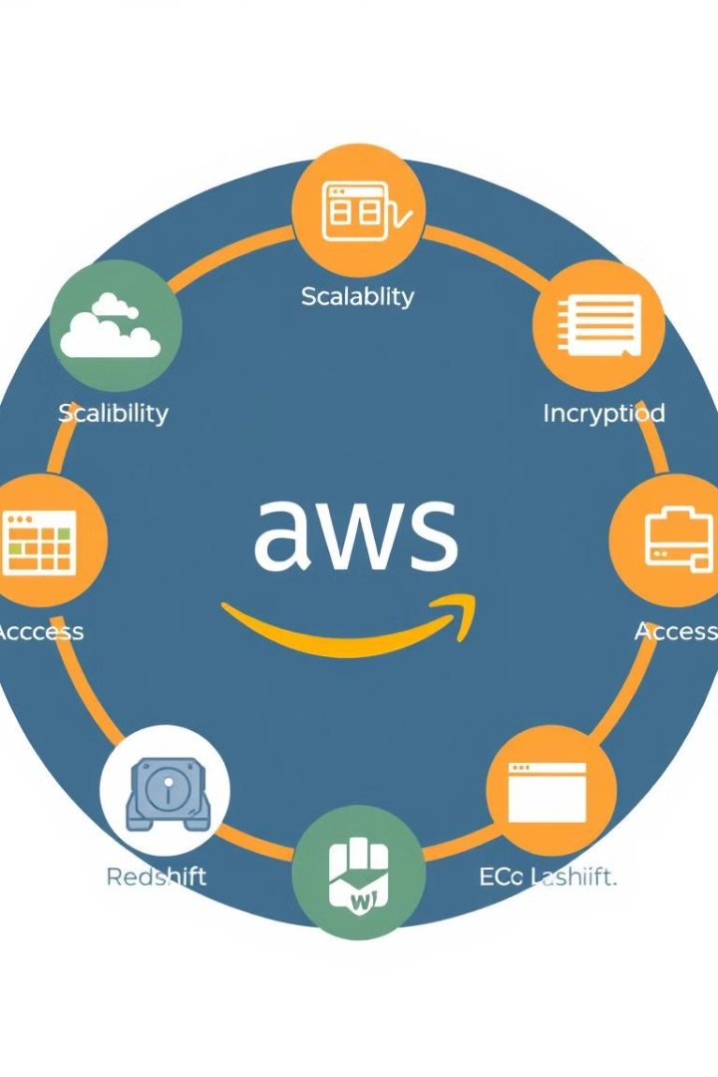
Key Features: Amazon Web Services (AWS) S3
1
Scalability & Durability
2
Storage Classes
S3 Standard, Intelligent-Tiering, and Glacier provide granular cost control.
Unlimited storage with 99.999999999% durability.
3
Security
Encryption, access controls, and compliance certifications ensure robust security.
S3 Intelligent-Tiering automatically moves data between frequent and infrequent access tiers based on usage patterns.

Slide 4

Key Features: Microsoft Azure Blob Storage
Scalability & Availability
Storage Tiers
Security & Compliance
Designed for massive scale and high availability.
Hot, Cool, and Archive tiers optimise for different access patterns.
Azure Active Directory integration, encryption, and compliance certifications ensure compliance.
Hot tier for frequently accessed data, Cool for infrequently accessed data, and Archive for long-term storage.

Slide 5
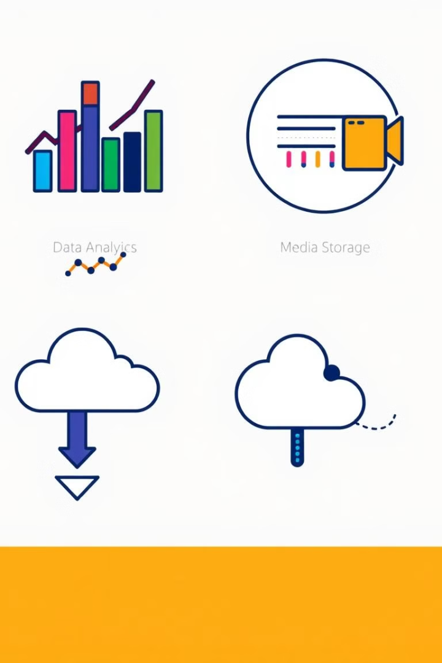
Use Cases: Google Cloud Storage
1
Data Analytics
Store large datasets for BigQuery and data science workloads.
2
Media Storage
Host images and videos for websites and applications.
3
Backup and Archiving
Long-term storage of backups and archival data.
YouTube leverages GCS for storing and streaming video content globally. Financial institutions use GCS for compliance.

Slide 6
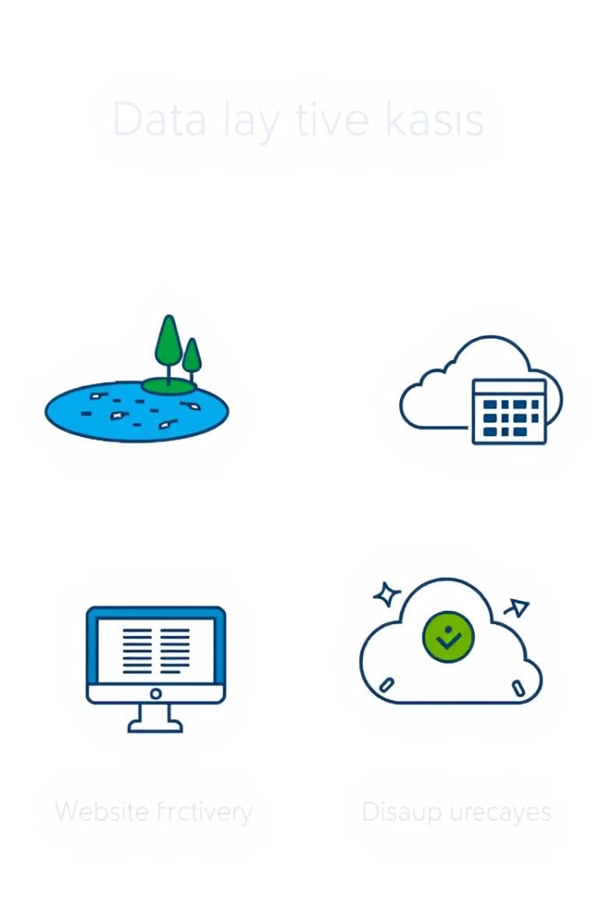



Use Cases: Amazon S3
Data Lakes
Build scalable data lakes for analytics and machine learning.
Website Hosting
Host static websites and web applications.
Backup and Disaster Recovery
Reliable backup and disaster recovery solutions.
Netflix uses S3 to store petabytes of data for personalized recommendations. Enterprises use S3 to back up critical data.

Slide 7



Use Cases: Microsoft Azure Blob Storage
Big Data Analytics
2
Store and process large datasets.
Cloud-Native Applications
1
Store data for cloud-native applications.
Backup and Recovery
Secure backup solutions for Azure workloads.
3
Store images and documents for a web application on Azure Kubernetes Service. Analyse IoT data. Back up virtual machines.

Slide 8
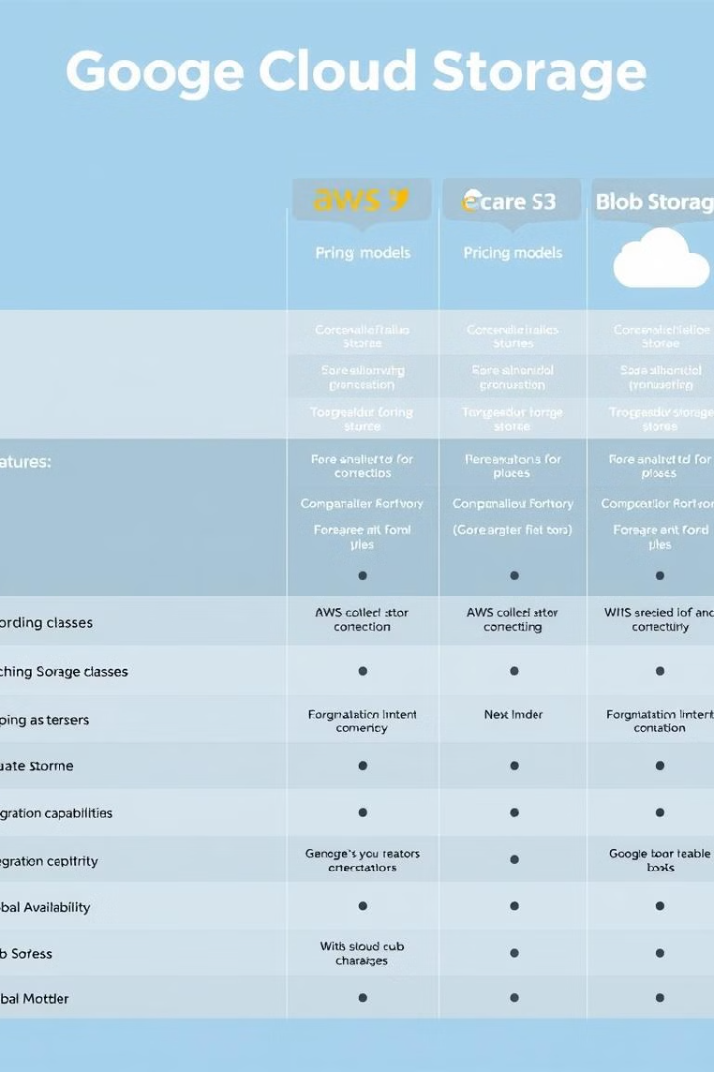
Key Differences: A Feature Comparison
Feature
Google Cloud Storage
Amazon S3
Azure Blob Storage
Pricing
Competitive for infrequent access
Diverse pricing tiers
Tiered prices
Integration
Deep Google Cloud integration
Extensive AWS ecosystem
Microsoft services
Performance
Varies by region
Varies by region
Varies by region
Global Reach
Global presence
Global presence
Global presence
GCS is competitive for infrequent access. AWS S3 has tiers. Azure blob storage is tiered. Network and data transfer costs vary.

Slide 9
Real-World Example: Multi-Cloud Strategy
AWS S3
1
Primary Storage
GCS
2
Backup & DR
Company X
3
Multi-Cloud Strategy
Company X uses AWS S3 for storage and GCS for DR. This provides redundancy and cost optimisation. Multi-cloud offers resilience.

Slide 10
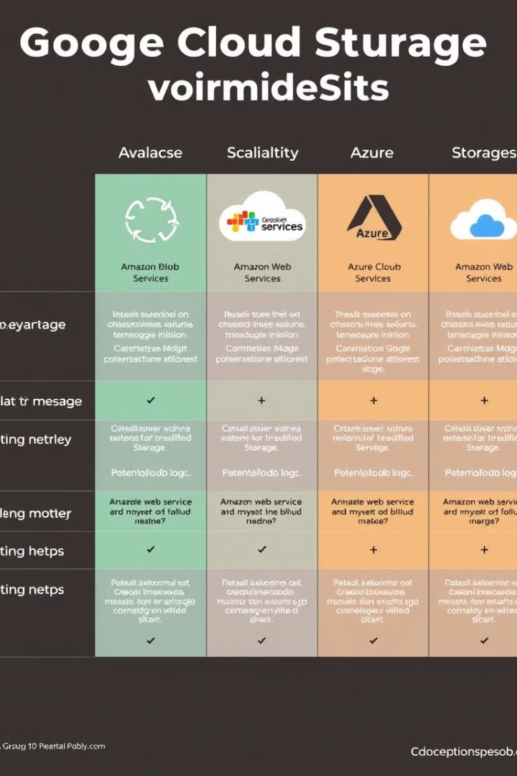
Conclusion: Choosing the Right Cloud Storage
Cost
Integration
Cost
Integration
Evaluate pricing.
Assess ecosystem fit.
Security
Security
Verify compliance.
Each offers strengths. Consider cost, integration, performance, and security. Cloud storage enables scalability and innovation.

